Slide 1





RUNTIME SYSTEM (Deep Dive)
presented by Bryan Hunter Firefly Logic
Twitter #cpl13 #erlang
@bryan_hunter
@fireflylogic

Slide 2


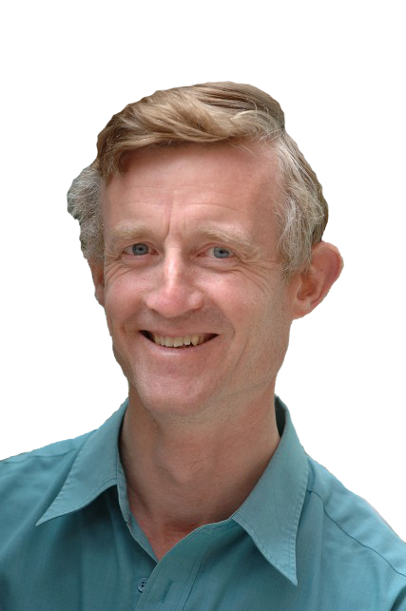
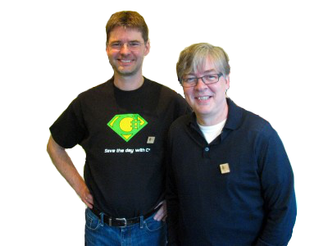
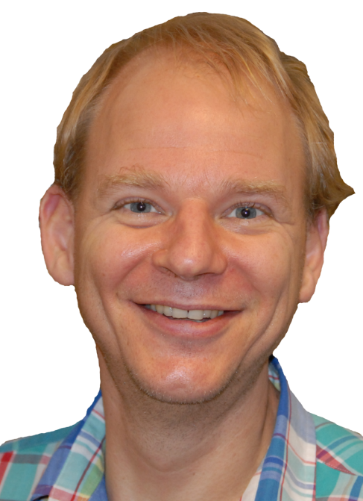
Booyah!
Ooo, ooo! I know!
What should
The Erlang Runtime System!
ing?
be
Good question, Bryan!

Slide 3
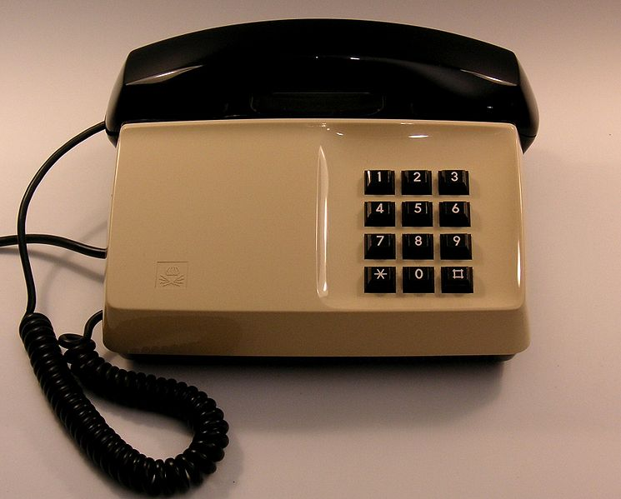
Why?

Slide 4
“Erlang is a programming language used to build
massively scalable
soft real-time systems
with requirements on high availability”
-from www.erlang.org

Slide 5


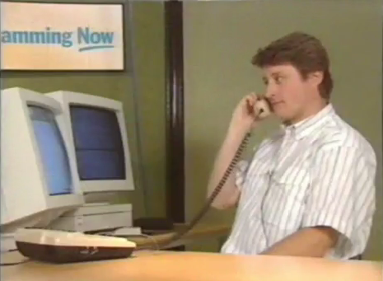

Joe
Mike
Robert

Slide 6
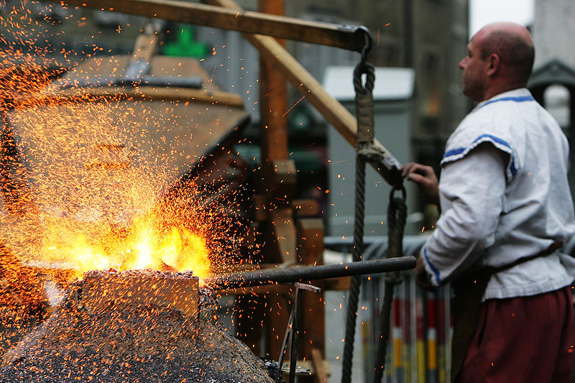
OTP
Erlang Runtime System

Slide 7

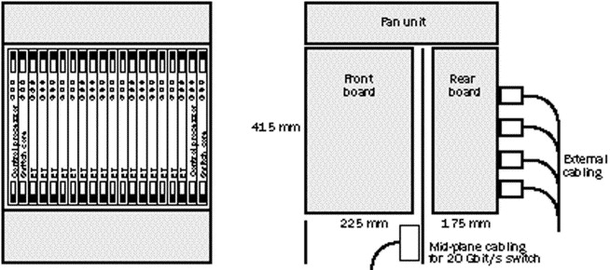
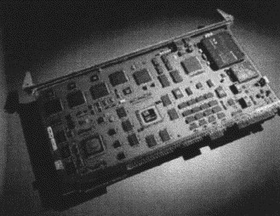
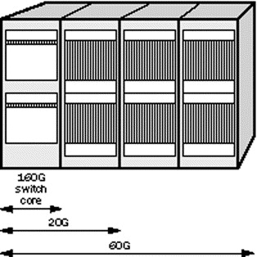
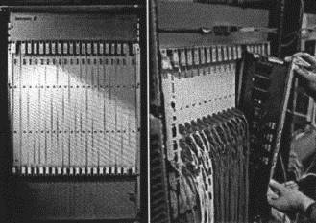

Slide 8















Erlang is proven

Slide 9
The Erlang Runtime System
is a special-purpose
operating system
built for
fault-tolerance,
concurrency,
and distribution

Slide 10
Erlang Runtime System (in-context)
.NET dev stack
Erlang dev stack
C# / F#
Erlang / Elixir / Joxa
.NET Framework
OTP
CLR
ERTS
VM + Kernel
+ STDLIB
OS (Windows)
OS (Windows, Linux, Mac, None)

Slide 11
The ERTS
(VM + Kernel + standard library)
provides the following support…

Slide 12
“a consistent operating system interface on all platforms”

Slide 13
“light-weight concurrency and support for millions of simultaneous tasks”

Slide 14
“memory allocation and real-time garbage collection”

Slide 15
“transparent co-operation between all computers in the system”

Slide 16
“location and encapsulation of run-time errors”

Slide 17
“supervision of run-time code as it loads, when it is replaced, and while it is linked.”

Slide 18
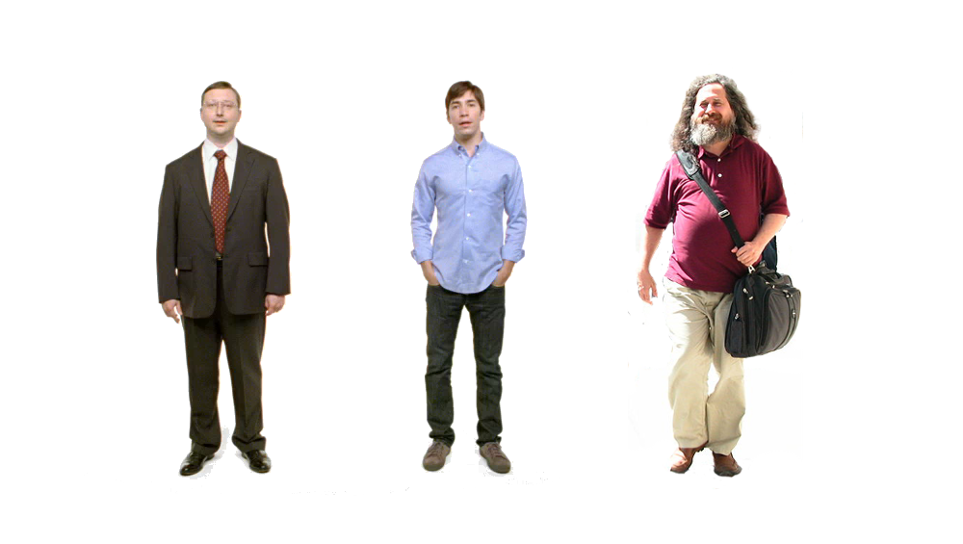

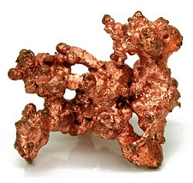
Erlang
Erlang
Erlang
Erlang
Erlang
ARM
> Consistent Operating System Interface on all Platforms

Slide 19
The kernel
The first application to be started.
It provides low-level services needed
to start the ERTS,
to participate in a distributed system,
to handle errors,
and to perform IO operations.

Slide 20
Internals of the ERTS
Match specifications
Crash dumps
Alternative carriers
The Abstract Format
TTY
Drivers
Inet configuration
External Term Format
Distribution protocol and the EPMD
Modules: erl_prim_loader, erlang, init, zlib, epmd
Commands: erl, erlc, werl, escript, erlsrv, strart_erl, erl_set_memory_block, run_erl, erl_driver, driver_entry, erts_alloc, erl_nif,
Schedulers
GC
Large binary heap
Signals

Slide 21
Fault-tolerance, low-latency soft-real time concurrency, location transparent distribution
The compiler : byte-code
Processes and the process control block
The Erlang Virtual Machine: BEAM
Modules and The BEAM File Format
Scheduling
The Erlang Type System and Tags
The Memory Subsystem: Stacks, Heaps and Garbage Collection
Advanced data structures (ETS, DETS, Mnesia)
Different Types of Calls, Linking and Hot Code Loading
BEAM Instructions (25p)
Platform Independence
Ports: IO and networking
BIFs NIFs and Linked in Drivers
Native code
The Shell
Operation and maintenance
Crash dumps
The Debugger
Tracing and Profiling
Tweaking and optimizing

Slide 22
Two thing to remember about
Concurrency
1) Shared memory concurrency is hard
2) Message passing concurrency is easy

Slide 23
“The performance
of a concurrent language
is predicated by three things:
the context switching time,
The message passing time,
and the time to create a process.”
–Mike Williams

Slide 24
Erlang Processes
are not Winows/Linux processes
They are the unit of concurrency
You structure your programs around these units of concurrency.

Slide 25
One .NET 4.0 Thread (allocates one megabyte)
**********
**********
**********
**********
**********
**********
**********
**********
**********
**********
**********
**********
**********
**********
**********
**********
**********
**********
**********
**********
**********
**********
**********
**********
**********
**********
**********
**********
**********
**********
**********
**********
**********
**********
**********
**********
**********
**********
**********
**********
**********
**********
**********
**********
**********
**********
**********
**********
**********
**********
Heap
Mailbox
Stack
**********
**********
**********
**********
**********
**********
**********
**********
**********
**********
**********
**********
**********
**********
**********
**********
**********
**********
**********
**********
**********
**********
**********
**********
**********
**********
**********
**********
**********
**********
**********
**********
**********
**********
**********
**********
**********
**********
**********
**********
**********
**********
**********
**********
**********
**********
**********
**********
**********
**********
Garbage Collector
Links and Monitors
One Erlang Process (allocates one kilobyte)
*
> light-weight concurrency

Slide 26
*
*
*
Reductions
- Do 2,000 operations
reduction1 reduction3 .
Reduction2000
- Move to the next guy - Repeat
CPU Core
> Near-zero context switching cost. Non-blocking.

Slide 27
worker
supervisor
*
*
CPU Core
> Supervision

Slide 28
***** *****
***** *****
***** *****
***** *****
Core
Core
Core
Core
> load balancing, linear scaling, real-time GC, load “unbalancing”

Slide 29

Distribution: built-in from the start
> transparent co-operation between all computers in the system

Slide 30
Distribution and Nodes
A “node” is an instance of the ERTS
net_adm:ping forms a cluster
Connections are transitive (by default)

Slide 31
Erlang Port Mapper Daemon
Started at every host where an Erlang node is started.
Responsible for mapping the symbolic node names to machine addresses.

Slide 32

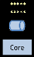
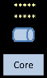
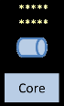
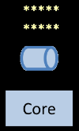
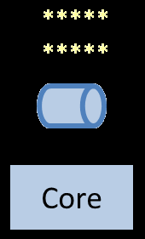

Slide 33
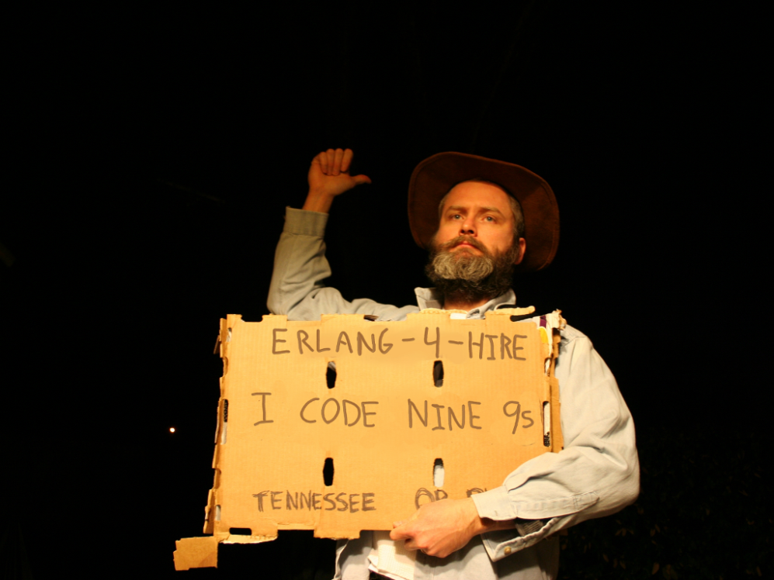
Nines | Uptime | Annual Downtime
9 | 99.9999999% | 30 milliseconds
8 | 99.9999990% | 300 milliseconds
7 | 99.9999900% | 3 seconds
6 | 99.9999000% | 32 seconds
5 | 99.9990000% | 5 minutes
4 | 99.9900000% | 53 minutes
3 | 99.9000000% | 8 hours, 46 minutes
2 | 99.0000000% | 3 days, 15 hours, 36 minutes
Safe
Supervisor
Worker
Worker
Links and monitors
No masters
Hot code loading
simple distribution, safe concurrency

Slide 34
[insert awe-inspiring demo here]

Slide 35
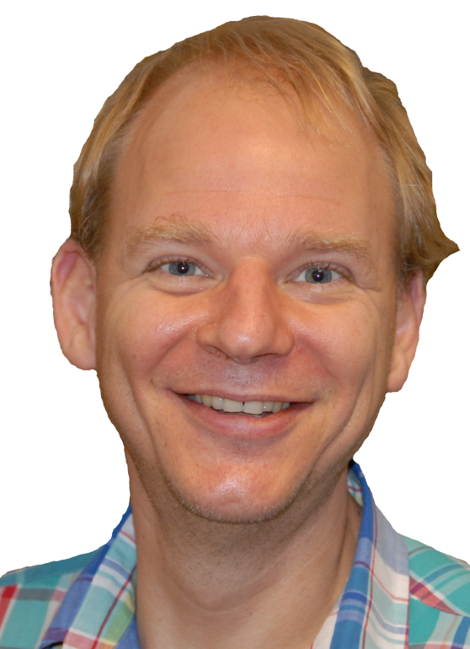
What should
ing?
be
Psst…don’t forget to show them my PDF

Slide 36
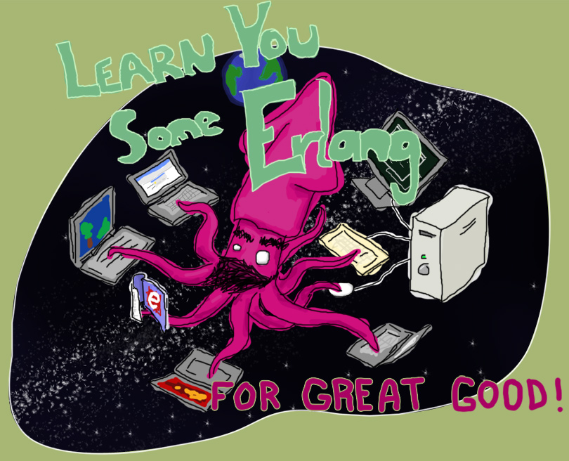
“Learn You Some Erlang for Great Good!” http://learnyousomeerlang.com/
How -> read this excellent and free online book

Slide 37



Start here
How -> read some books

Slide 38

Search “pragmatic kevin smith”
How -> code alongside Kevin Smith for eight screencasts

Slide 39
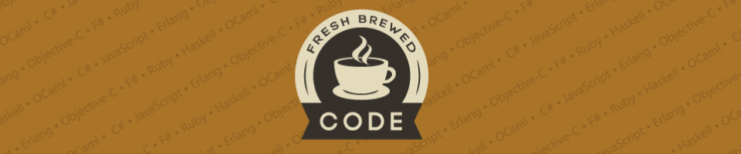
My blog:
http://freshbrewedcode.com/bryanhunter/
How -> visit my blog

Slide 40
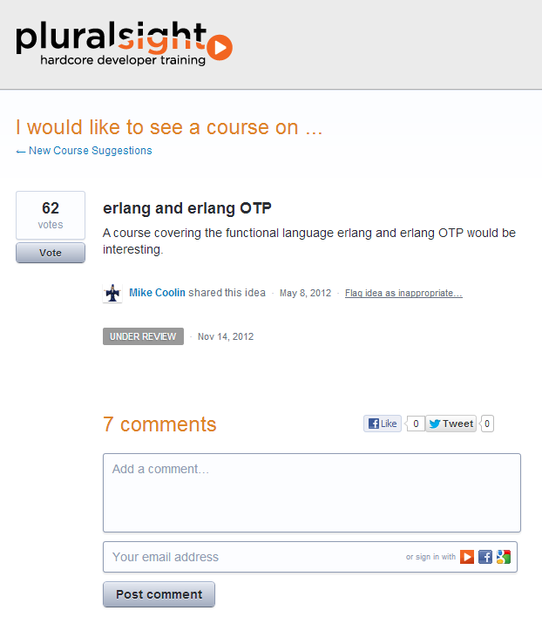
How -> Nag Pluralsight

Slide 41

http://lambdajam.com
How -> buy your tickets now

Slide 42

http://erlangcamp.com
How -> Come to Nashville in October!

Slide 43

http://nashfp.org
How -> Better yet; pack up and move to Nashville!

Slide 44
Bryan Hunter
Twitter: @bryan_hunter
Email: bryan.hunter@fireflylogic.com
Blog: codeswamp.com
Firefly Logic, Inc.
1000 Main Street, Suite 201 Nashville, TN 37206
http://fireflylogic.com
How -> keep in touch

